Slide 1

Patient Safety Risks with AI for Diagnosis
Health and Medical Sciences Seminar
School of Computing
1st April 2020
15:00 – 15:40
The theoretical and practical foundations of
safety informatics:
theory development workshop series
Workshop 1: the novel challenges that new and emerging digital technologies pose for patient safety
Introductions: Owen Johnson, Computing, University of Leeds
Online
21st April, 2020
10.30-12.30

Slide 2
Agenda
10.00 – 10.30 Registration and coffee* – informal networking
10.30 – 11.00 Introductions to the workshops, team and tools (Owen)
11.00 – 11.30 Talk – the novel challenges (Ciáran)
11.30 – 12.00 Breakout sessions – three groups
12.00 – 12.30 Synthesis and next steps
12.30 – 13.00 Lunch* and networking opportunity
14.00 – 15.00 Paper writing team – small group session
Follow up work using online tools/ email
* self service, sorry.

Slide 3
Aim of the Workshop Series
Aim
These workshops are aimed at developing a stronger, multidisciplinary framework for safety informatics.
Objectives
Understanding the issues involved in the interaction between digital health and patient safety.
To provide a robust academic appraisal of the evidence base and subject-matter expertise.
To produce key position papers and research agenda papers that define the field of safety informatics and serve as a platform for future research and development.
Once established, we will open the discussion to the broader digital health community by running themed sessions at major international conferences and meetings.

Slide 4


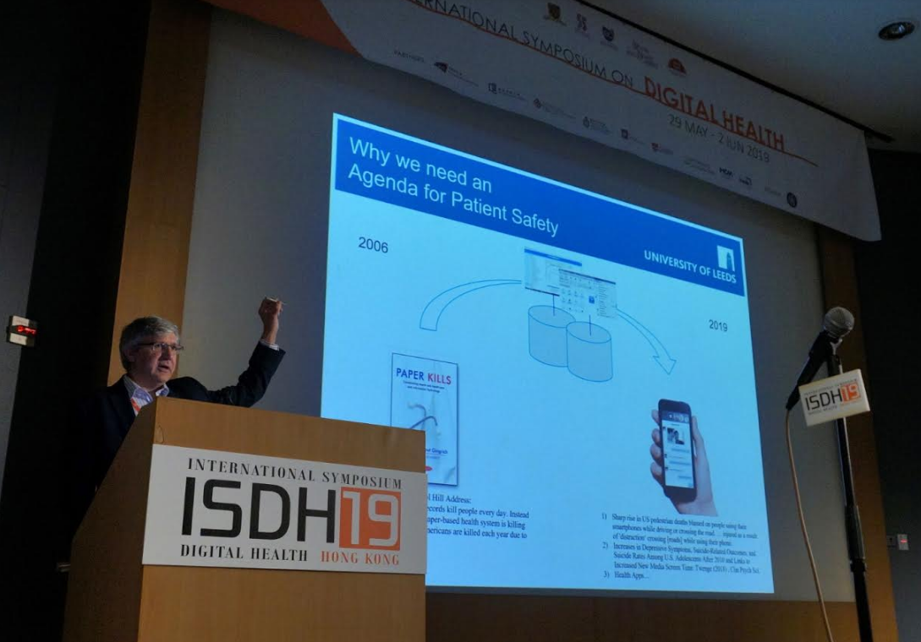
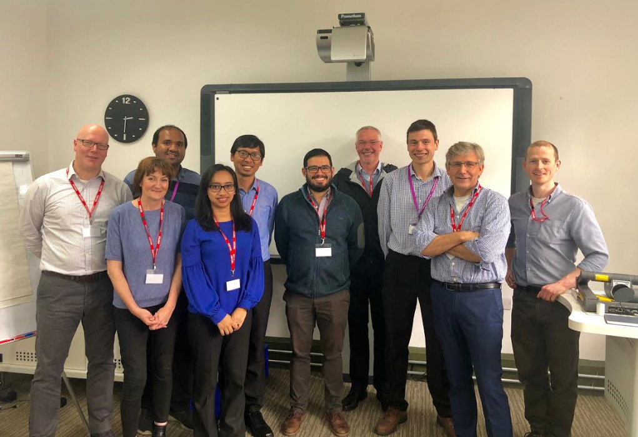
Introductions – to the patient safety centres
Introductions to each other
· Who
· Relevant background + Theory perspectives
· Personal goals for the day

Slide 5
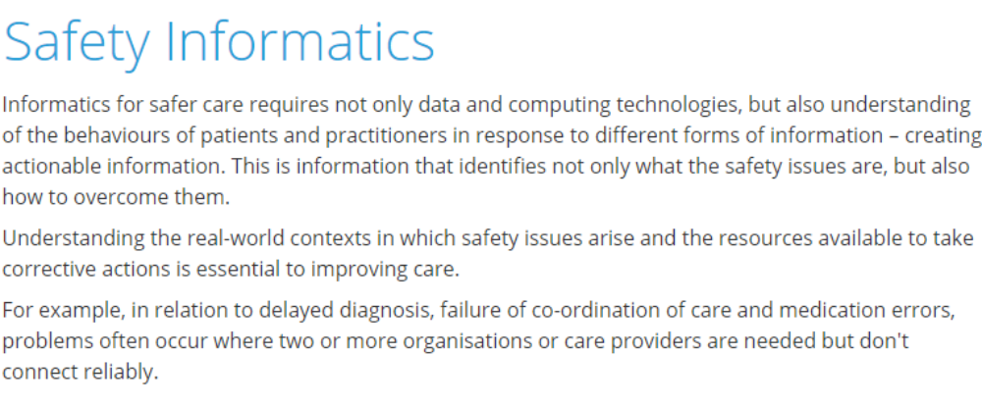
Introduction to Safety Informatics
Patient Safety
Digital Health
Safety
Informatics
http://www.patientsafety.manchester.ac.uk/research/themes/safety-informatics/

Slide 6
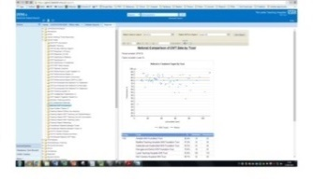
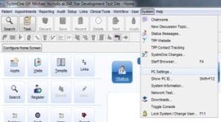


Patient Safety and Digital Health
2006
2020
Newt Gingrich, 2006, Capitol Hill Address:
“It's simple, paper medical records kill people every day. Instead of saving lives, our current paper-based health system is killing them. As many as 98,000 Americans are killed each year due to medical errors.”
Sharp rise in US pedestrian deaths blamed on people using their smartphones while driving or crossing the road. … injured as a result of 'distraction‘ crossing [roads] while using their phone.
Increases in Depressive Symptoms, Suicide-Related Outcomes, and Suicide Rates Among U.S. Adolescents After 2010 and Links to Increased New Media Screen Time. Twenge (2018) , Clin Psych Sci.
Health Apps and AI …

Slide 7


An appreciation that
Health Information Systems are complex ecosystems
I’m a new clinical algorithm and I can go anywhere
Oh,
I see
Perfect temperature and salinity
Unknown temperature and salinity

Slide 8
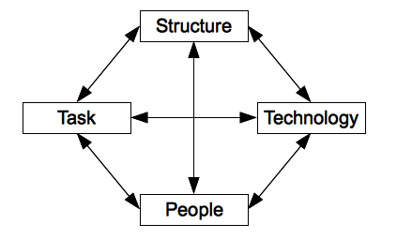
A Health Information System is a complex socio-technical system
Data in Health Information Systems is generated as the output of a complex interplay of four forces that are always changing and always affecting each other in non-linear ways.
Endless Change
Endless Change
Endless Change
Endless Change
NewData
Leavitt Diamond (1965)

Slide 9


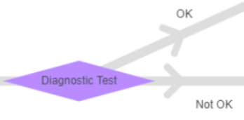
The “Tottering Tower” of AI in Health
AI sits (poorly) on top of (changing)
Health Information Systems
Care decisions
Care pathway
Working practice
Health Information System
Other Information Systems
Data
Technical Infrastructure

Slide 10
Opening questions
Q. What would a Unified Theory of Patient Safety Informatics (UTOPSI) look like?
a toolbox not hammer; what’s in your toolbox?
Q. Who is not in the room? Stakeholders?
Patients (PPI&E)
Clinical colleagues (Tom Lawton, Brad, …)
Health IT professionals (CIOs)
National bodies (NHS Digital Patient Safety Team)
International colleagues (ISDH)

Slide 11
The Workshop Series
Rationale: Major gaps in translational patient safety theory in relation to digital health are evident; multiple theories exist from multiple perspectives and from very different disciplines with no common language suitable for multi-disciplinary evaluation of emerging digital innovations.
Approach: Understanding the issues involved in the interaction between emerging digital technologies and patient safety requires a multidisciplinary perspective in order to identify and develop potentially valuable research themes.
We proposed initial themes for discussion, though new ones may emerge :
1) The novel challenges that new and emerging digital technologies pose for patient safety
2) The implications of contemporary safety theory (Safety-I and Safety-II) for digital innovation
3) Sociotechnical evaluation of digital technologies and their implementation for safe and reliable care
4) Digital technologies for improving patient safety
In terms of the expertise we wish to bring to bear upon these themes, we propose to engage the following core subject-matter domains through network membership:
• Software engineering testing
• Learning health systems
• Health informatics theory
• Technology and risk acceptance
• Human factors and implementation science

Slide 12
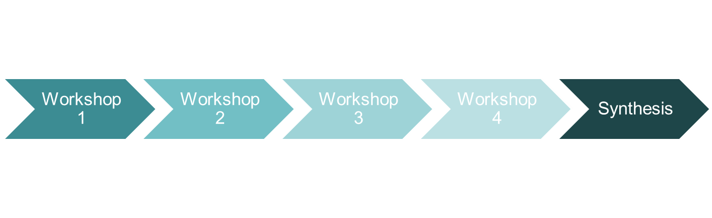
An output based approach
draft paper
draft paper
draft paper
draft paper
Writing group
Writing group
Writing group
Writing group
Submitted paper
Co-author input
Co-author input
Co-author input
Co-author input
Submitted paper
Submitted paper
Submitted paper
Submitted paper
See, for example: Michie, S., Yardley, L., West, R., Patrick, K. and Greaves, F., 2017. Developing and evaluating digital interventions to promote behavior change in health and health care: recommendations resulting from an international workshop. Journal of medical Internet research, 19(6), 232.

Slide 13
Writing the paper
Involved once
Contribution
Contribution
workshop attendees
co-authors
writing team
lead author
senior author
Submitted paper
Review
Review
Following the rules here: http://www.icmje.org/recommendations/browse/roles-and-responsibilities/defining-the-role-of-authors-and-contributors.html

Slide 14
Design of the Workshops
We will conduct a series of six workshops over an 18-month period.
We will collaborate initially with a core team of experts in safety informatics, invited from the established leading Patient Safety Research Centres in the UK, and then engage with national expertise and the international community of digital health researchers and practitioners.
Each workshop will feature a full one-day programme with attendance by invitation only, hosted by participating Research Centres.
The format will include presentations by invited subject-matter experts, followed by group discussion and consensus building to identify evidence gaps and develop theory to support future research and development.
We plan to publish the outputs from the workshops in peer-reviewed academic journals.

Slide 15
Guide to the online workshop
Still happening…
Shorter. But we can continue online and/ or do another
Tools. We are all learning how to best to use them
Time keeping. Short and sharp, let’s finish on time and chat after
Issues and ideas. Identify but let’s not try to solve
Focus. There are more workshops, sessions, emails
Output. Please make notes and email after
Chat. Use the online chat option for questions and comments
Mics. Mute them during presentations
Record. We will record for internal note taking use only
Tools
Collaborate Ultra - for the call
Padlet – for the breakout sessions and synthesis
Paper writing – Word, Github (repository/ version control), Mendeley (references)

Slide 16
The Plan
Novel patient-safety challenges posed by new and emerging health information technologies:
A workshop of the 'Theoretical and Practical Foundations of Safety Informatics' series
(This document was created using https://www.makeareadme.com)
Event details:
Location: University of Leeds.
Date: Tues 21st April 2020.
Menedeley group folder for resource sharing.
Early career researcher: Ciarán McInerney, PhD. (ORCID, Twitter, Staff profile)
Folder contents:
Draft workshop publication in PDF format, for viewing;
Draft workshop publication in DOCX format, for comments; and
Exemplar publication series on which the draft is based ("Michie et al_2017.pdf").
Requested actions:
As an invitee to this folder, you are requested to undertake the following actions:
Before the workshop
Review the draft publication;
Suggest 3 citations relevant to the draft paper;
Consider what your contribution to the publication could be (optional); and
Upload any relevant literature to the Mendeley workshop series' group folder.
After the workshop
Amend the draft publication DOCX in accordance with agreed actions from the workshop; and
Upload any relevant literature to the Mendeley workshop series' group folder.
Thank you for your contribution to the 'Theoretical and Practical Foundations of Safety Informatics' series

Slide 17
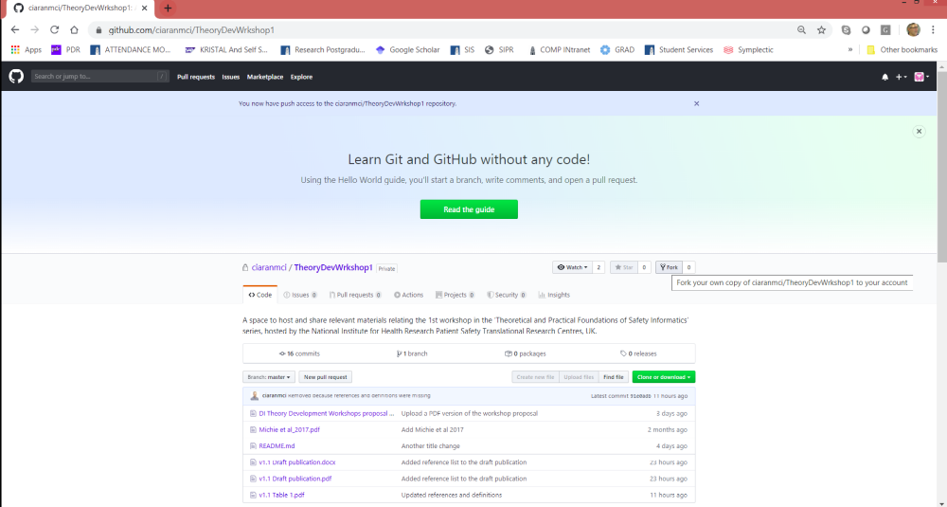
GitHub

Slide 18
Agenda
10.00 – 10.30 Registration and coffee* – informal networking
10.30 – 11.00 Introductions to the workshops, team and tools (Owen)
11.00 – 11.30 Talk – the novel challenges (Ciáran)
11.30 – 12.00 Breakout sessions – three groups
12.00 – 12.30 Synthesis and next steps
12.30 – 13.00 Lunch* and networking opportunity
14.00 – 15.00 Paper writing team – small group session
Follow up work using online tools/ email
* self service, sorry.

Slide 19
Patient Safety Risks with AI for Diagnosis
Health and Medical Sciences Seminar
School of Computing
1st April 2020
15:00 – 15:40
The theoretical and practical foundations of
safety informatics:
theory development workshop series
Workshop 1: the novel challenges that new and emerging digital technologies pose for patient safety
Introductions: Owen Johnson, Computing, University of Leeds
Online
21st April, 2020
10.30-12.30

